Slide 1
Improving AI in the Medical Field:
Elevating Diagnostics, Health Monitoring, & Drug Development
Edris Lutfi, Ella Chow, Oriana Rueckert, Sydney Piatkowski, Tim Morcombe & Lewis Song

Slide 2
Introduction

Slide 3
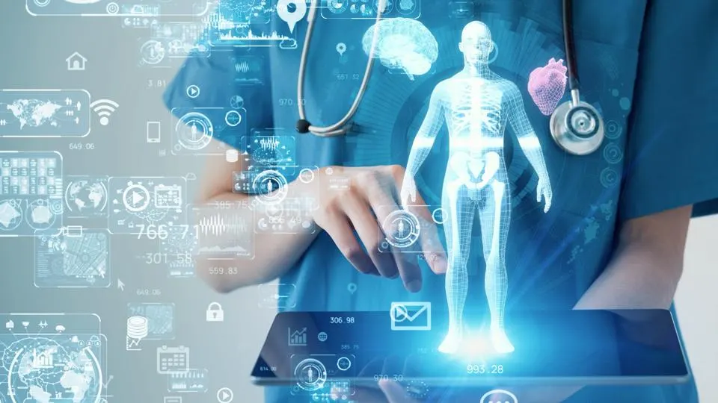
We will examine:
Current uses of AI in healthcare
The future of the industry
Developmental framework

Slide 4
The Problem
The population is set to increase by 2 billion in the next 30 years (United Nations, n.d.), and post-pandemic, healthcare institutions have reached all-time high levels of stress, burnout, and physician turnover (Glazier, 2023). The growing population will only exacerbate these structural challenges in the healthcare industry, making it difficult for people to access the health services they require.
Solving this problem would reduce stress on healthcare institutions and staff, as well as ensure patients receive quality, timely care fitted to their needs.
Notes:
Ella

Slide 5
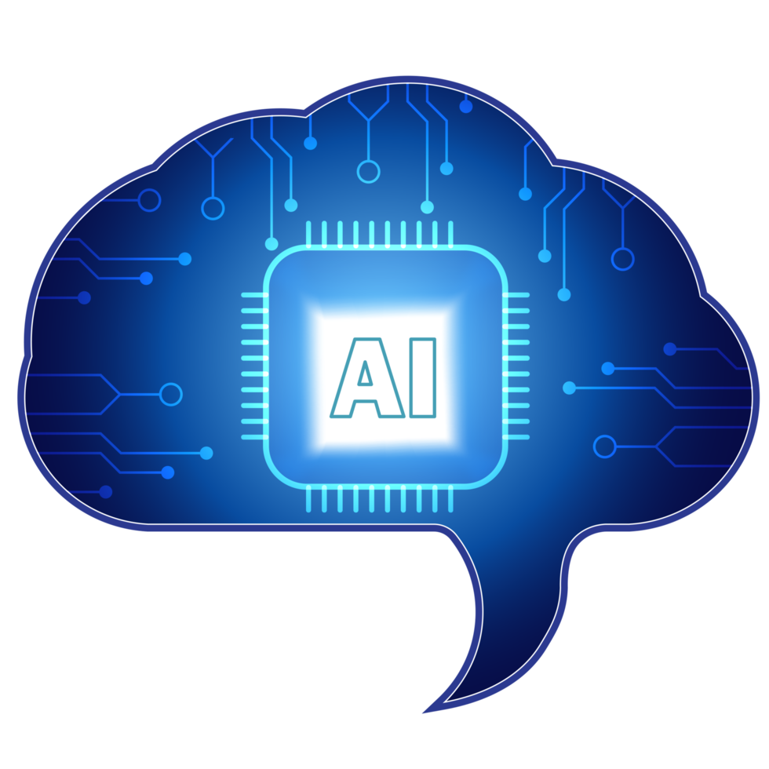
In Comes AI…
AI’s quick processing speeds and comparability to human intelligence could be used to optimize and streamline healthcare in all industries!
Diagnostics
Personalized care + precision medicine
Pharmaceuticals
Disease tracking + health monitoring

Slide 6
State of Knowledge

Slide 7
“Over 35 million new cancer cases are predicted in 2050, a 77% increase from the estimated 20 million cases in 2022” (Global Cancer Burden Growing, amidst Mounting Need for Services, 2024).
Notes:
Oriana

Slide 8
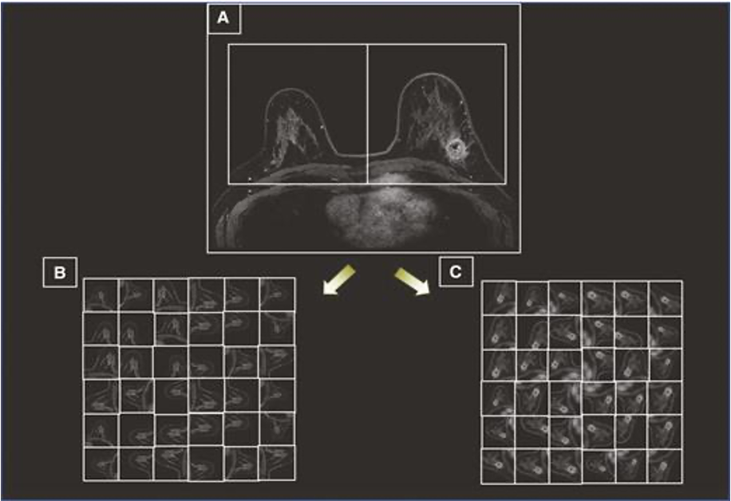
AI in Medical Imaging Diagnostics - Breast Cancer
Figure 1.
Results of AI Algorithm Used on Breast MRI Images
Deep learning algorithms can identify tumours from medical images (Eskeris-Winkler et al., 2021).
These are axial breast MRI images used in the diagnosis of breast cancer.
The images are being sorted into B, which is tumour-free breast tissue and C, cancer-containing breast tissue.
Note. Image from Eskreis‐Winkler, S., Onishi, N., Pinker, K., Reiner, J. S., Kaplan, J. B., Morris, E. A., & Sutton, E. (2021). Using Deep Learning to Improve Nonsystematic Viewing of Breast Cancer on MRI. Journal of Breast Imaging, 3(2), 201–207. https://doi.org/10.1093/jbi/wbaa102
Notes:
Oriana

Slide 9
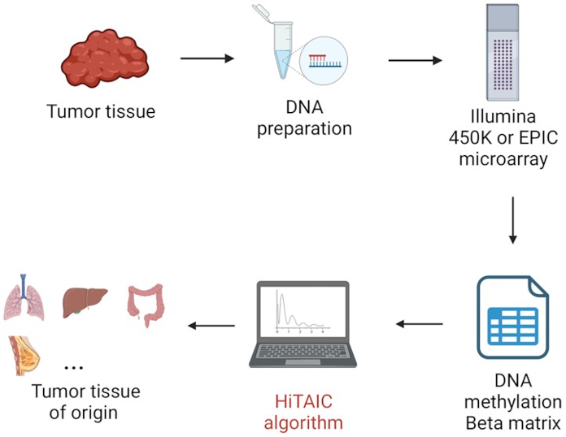
AI in Medical Imaging Diagnostics - Brain Cancer
Figure 2.
“HiTAIC is a DNA methylation-based multilayer perception classifier that traces the tissue of origin and tumor type in primary and metastatic tumors” (Zhang, Lu, et al., 2023).
Deep learning systems have been found to be able to determine if brain tumours are methylated (Zhang, Lu, et al., 2023).
This is a very important factor in brain tumour treatment and therefore quality of life for patients.
Note. Image from Zhang, Z., Lu, Y., Soroush Vosoughi, Levy, J., Christensen, B., & Salas, L. (2023). HiTAIC: hierarchical tumor artificial intelligence classifier traces tissue of origin and tumor type in primary and metastasized tumors using DNA methylation. NAR Cancer, 5(2). https://doi.org/10.1093/narcan/zcad017
Notes:
Oriana

Slide 10
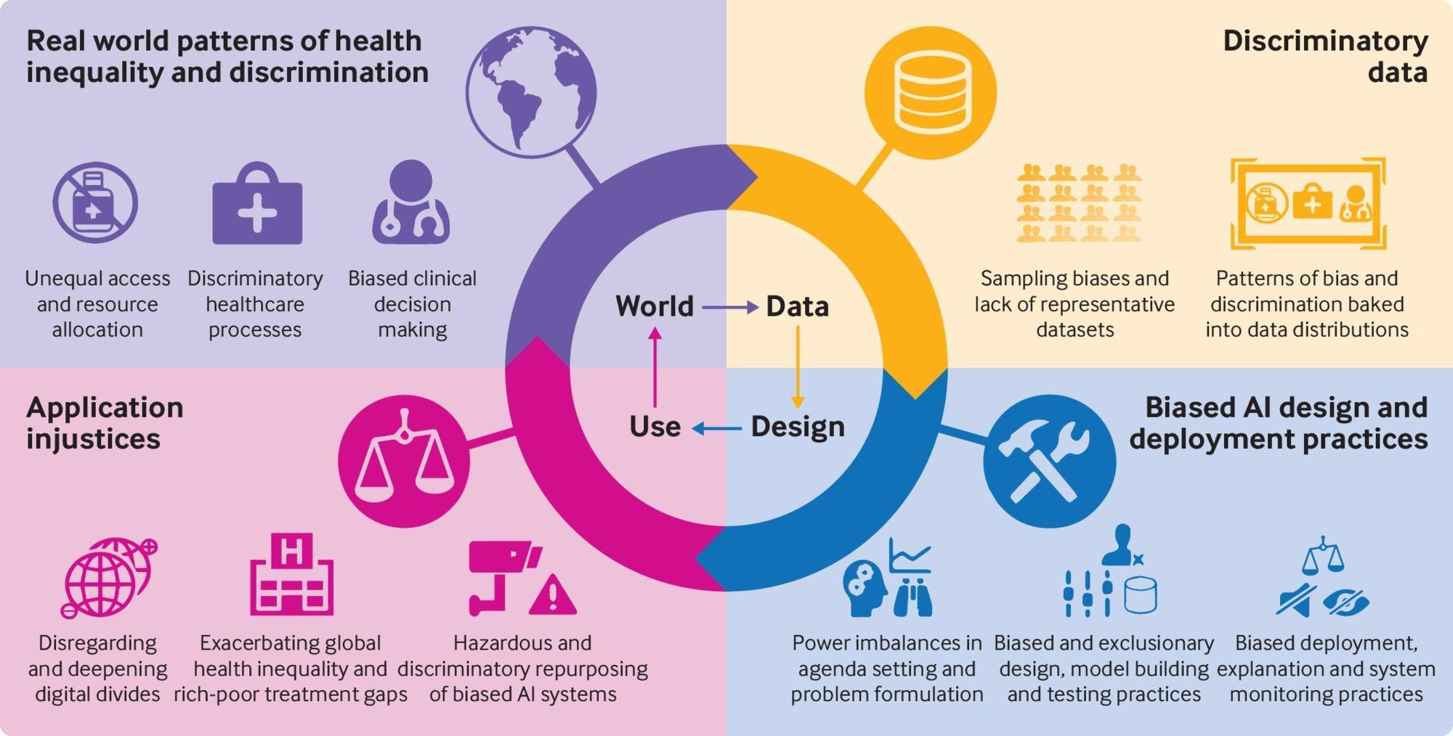
AI in Medical Imaging Diagnostics - Bias
Figure 3.
Bias and discrimination in the design and use of AI systems.
Patient privacy is of utmost importance in the healthcare field.
Due to the black box nature of AI systems, confidentiality is a major concern.
In any AI system, it is also important to limit bias and prejudice in the creation and implementation of such systems.
Note. Image from Dilmegani, C. (2023, September 11). Bias in AI: What it is,
Types & Examples, How & Tools to fix it. AppliedAI.
https://research.aimultiple.com/ai-bias/
Notes:
Oriana

Slide 11
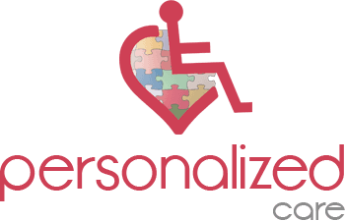
AI in Precision Medicine
Advancing personalized care
and health monitoring!

Slide 12
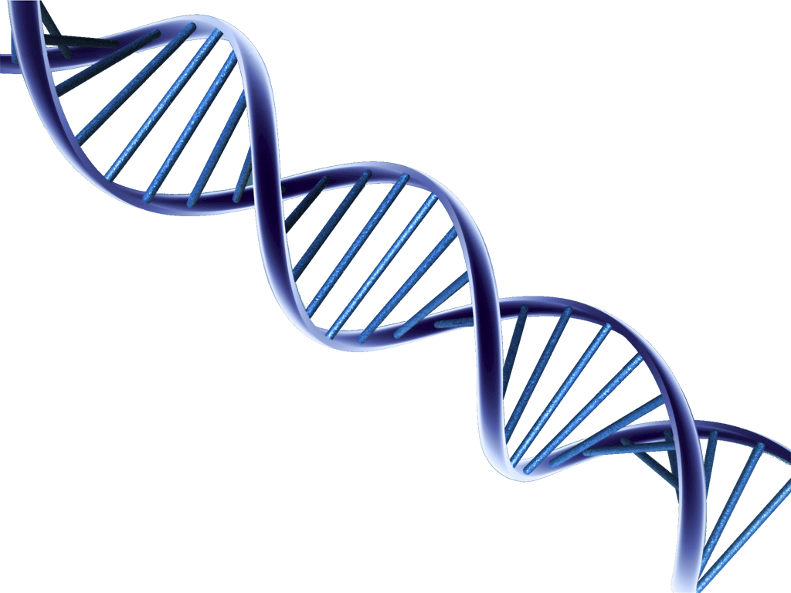
Genomic Analysis
AI can identify protein configurations, gene expression and DNA transcription sites.
This is key for identifying disease presentation in the human genome (Johnson et al., 2021).

Slide 13
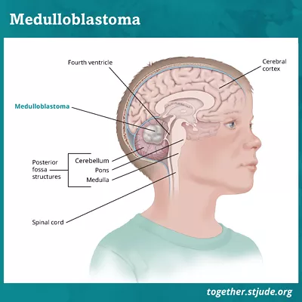
Medulloblastoma Treatment… Case by Case
Medulloblastoma: cancerous brain tumour
Typical treatment:
Chemotherapy
Surgery
Brain radiation therapy
But some patients (typically children) with certain genomes only require chemotherapy.
AI can quickly assist in genome profiling and prevent excessive treatments (Johnson et al., 2021).
Figure 4.
Medulloblastoma Diagram
Note. Image from St. Jude Children’s Research Hospital. (n.d.) Medulloblastoma in children and teens. https://together.stjude.org/en-us/about-pediatric-cancer/types/brain-spinal-tumors/medulloblastoma.html

Slide 14

AI Sensors and Remote Monitoring
EmPowerYu: AI platform that detects actions and assess behaviours
Tracking behaviour → helps measure signs of cognitive decline (neurodegenerative disorders).
More software:
Analyzes semantic coherence in speech → marker for cognitive disorders (e.g. Parkinson’s, etc…)
75% accuracy!
(Gold et al., 2018)

Slide 15


Ethical Concerns…
Bias in health data sets
Lack of diversity
Global efficacy
Thailand clinics cannot provide high-quality data (images, etc…) required for accurate AI predictions
Slow internet = reduced processing speeds → longer wait times
(Beede et al., 2020)

Slide 16
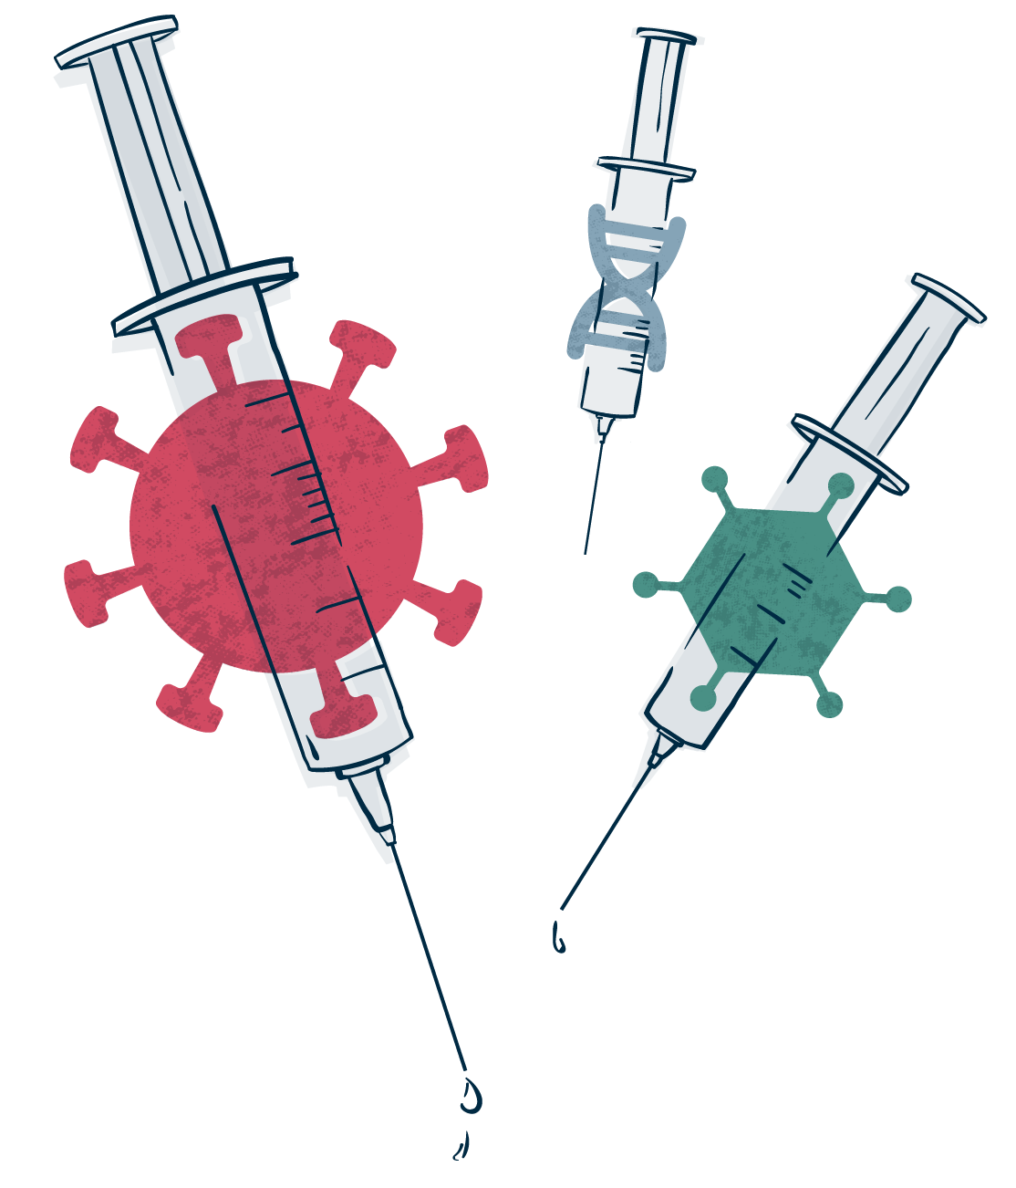
AI in Pharmaceutical Development
Designer drugs

Slide 17
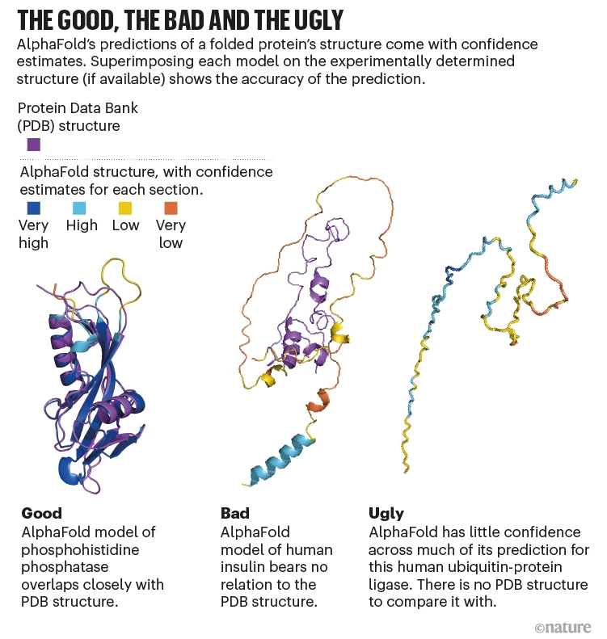
AlphaFold
Figure 5.
Protein structures predicted by AlphaFold & associated accuracies
Deep-learning neural network
Can predict 3D protein shapes from its amino acid sequence (Callaway, 2022).
Matches inputs with related sequences discovered in training databases.
As of 2021: can predict structures for 330 000 proteins → projected to predict 130 million structures (Chun, 2023).
Note. Image from Callaway, E. (2022). What’s next for AlphaFold and the AI protein-folding revolution. Nature, 604, 234-238. https://doi.org/10.1038/d41586-022-00997-5

Slide 18

More Developments
AI can now hallucinate structure predictions with optimized structure design required for vaccines and drugs (Callaway, 2022).
Speeds up time consuming fabrication processes from months → seconds
Increases speed and viability of early-stage vaccine development
Low cost
Lower computing power required than before

Slide 19
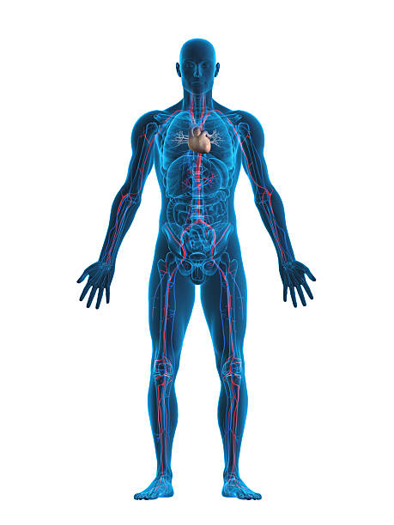
Drug Screening
Deep-learning algorithms can analyze drugs and predict:
Toxicity;
Bioactivity;
Interactions with other molecules; and
Other physicochemical properties (Paul, 2021).
Analyze and forecast drug effectiveness by comparing inputs from databases.
Quick analysis helps launch researchers into further trials and experimentation.

Slide 20

Pros and Cons…
Increased speed in drug development and testing processes
Increases production viability by lowering testing costs
Limited data sharing
Data is necessary for accurate, reliable systems (Mock et al., 2023).
Screening complex drugs requires extensive data - but it’s hard to come by.
Corporations fear data-sharing
Gives more power to competing developers.

Slide 21
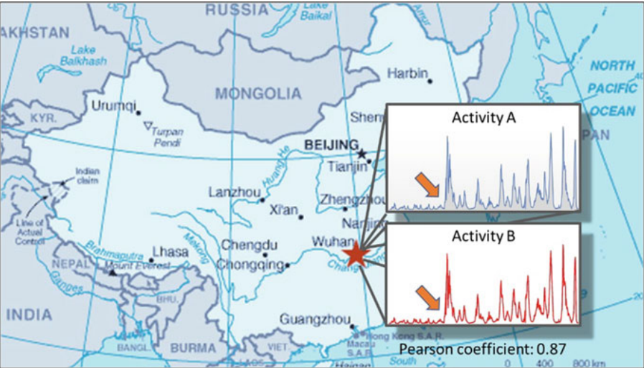
Hot Spot Tracking and Prediction
What about large scale diagnostics?
Can AI predict and recognize outbreaks of diseases?
Note: Image from Fong, S. J., Dey, N., & Chaki, J. (2021). Artificial Intelligence for Coronavirus Outbreak. In SpringerBriefs in Applied Sciences and Technology. Springer Singapore. https://doi.org/10.1007/978-981-15-5936-5
AI can actually diagnose larger areas by recognizing clusters or “hot spots” of certain diseases through its collection and analysis of data from health experts and the media. It can then be successful in contact tracing, monitoring the individuals who are at risk, and tracking the overall spread of diseases. This presents impacted people and healthcare professionals with a head start on the battles against disease (Vaishya et al., 2020).

Slide 22



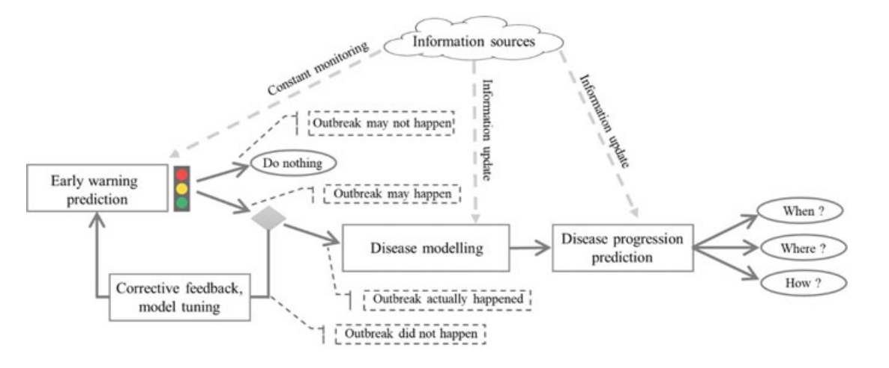
Data Collection From Social Media
Data collection from social media is controversial in society, but when regulated, is a huge asset to heath emergency tracking.
The model sorts through the data obtained from social media, separating the informative data from the irrelevant data using natural language processing and semantic web technology. It looks for various keywords that have different weights based on their relevance to the emergencies (Huang et al., 2022).

Slide 23
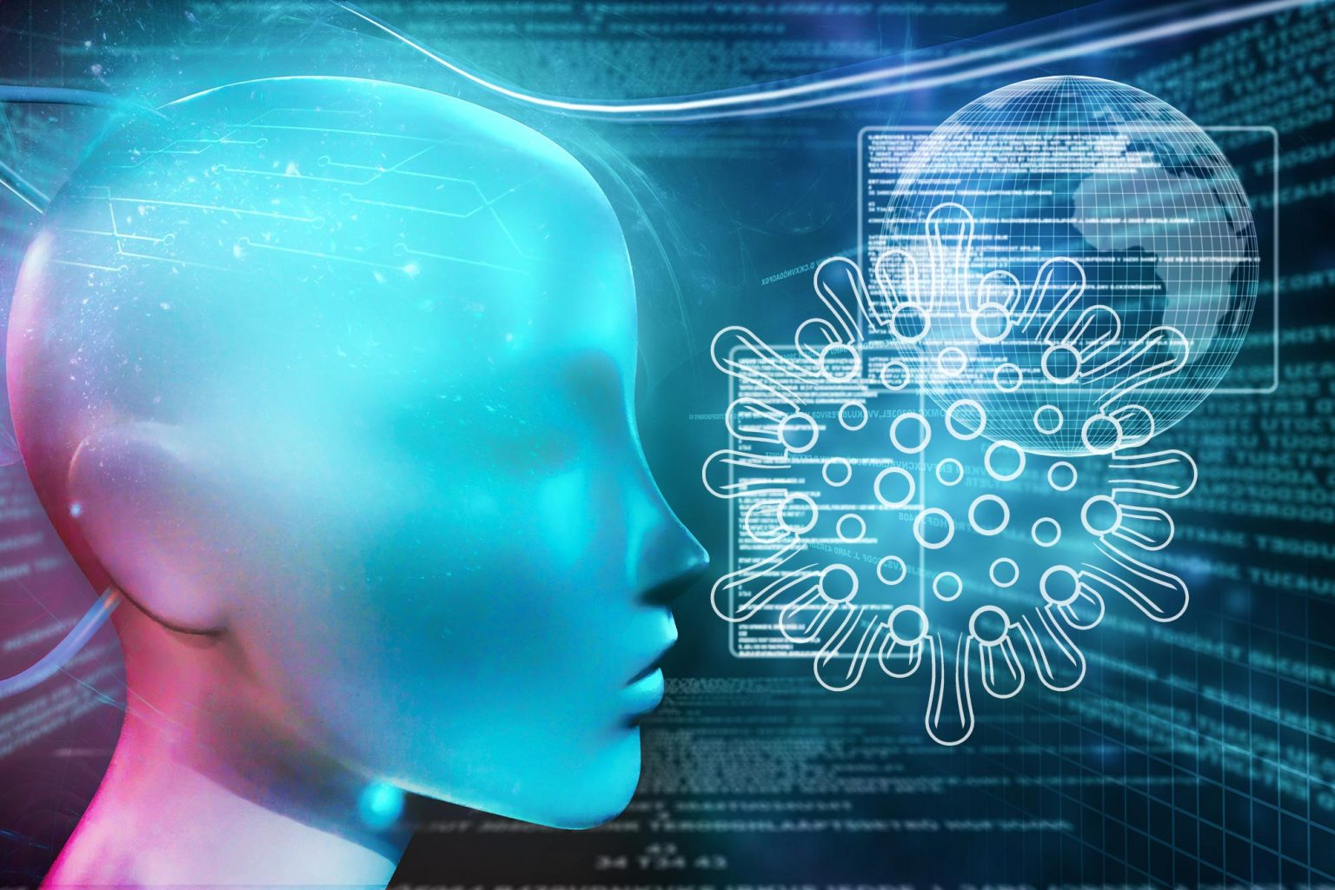
COVID-19
AI models looked at factors such as:
Flights (To & From)
Traffic (Direction & Intensity)
Purchases of supplies
Movement of medical personnel
Sentiments and symptoms of people on Social Media (including visuals)
It can pinpoint these locations as having unusual activity and continues to track their data until a threshold is reached at which point it could be declared an outbreak and precautions could be taken. The process notifies and gets help to impacted people significantly faster than otherwise (Fong et al., 2021).

Slide 24
Future Outlook

Slide 25
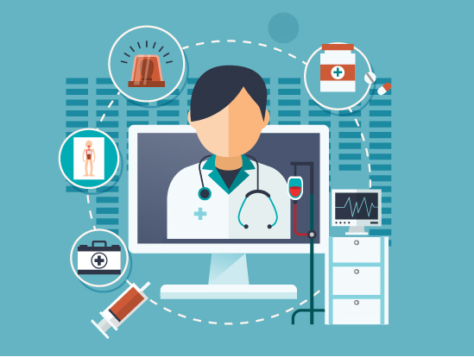
Future of Medical Imaging Diagnostics with AI
In the future Artificial Intelligence applications in medical diagnostic and personalized medicine holds immense potential for expansion within the healthcare industry.
AI has evolved as a useful tool to provide greater efficiency in clinical care. AI diagnostics with skilled learning advancements provide faster and more precise diagnoses from X-Rays, MRI, and CT scans (Samson, 2023).
AI also produces more:
Precise diagnostics
Quicker results
Personalized treatment
Advanced analysis on medical imaging
Notes:
Precise diagnostics the human eye can miss
Quicker results
Personalized treatment that can help in the fastest way possible
Advanced analysis on medical imaging that can catch a diagnosis earlier than the human eye and prevent them before becoming a bigger and more serious issue

Slide 26
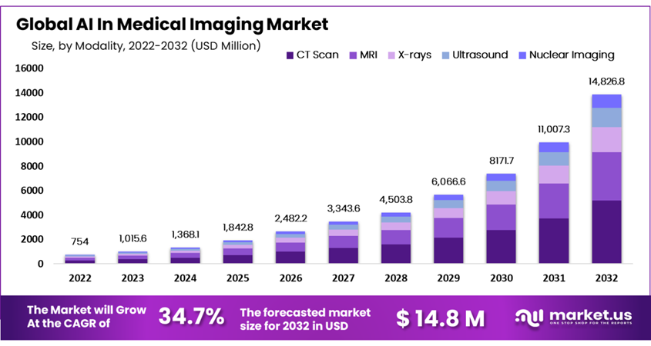
AI in the Medical Imaging Market
With AI using algorithms that can easily analyze medical images with impeccable accuracy, the algorithms easily detect subtle abnormalities and patterns that would regularly pass the human eye.
Since AI’s ability to adapt and grow with machine learning to continuously grow its medical image knowledge, AI is making tremendous progress in the medical field (Najjar, 2023 )
Note :Image from Najjar, R. (2023, August 25). Redefining radiology: A Review of Artificial Intelligence Integration in medical imaging. Diagnostics (Basel, Switzerland). https://www.ncbi.nlm.nih.gov/pmc/articles/PMC10487271/
Notes:
Therefore, with AI continuously being more precise in its ability to diagnosis, the market of AI has increased immensely since 2022 and is predicted to increase over the years
Therefore the market of AI in medical imaging has increased immensely since 2022 and is predicted to continuously grow

Slide 27
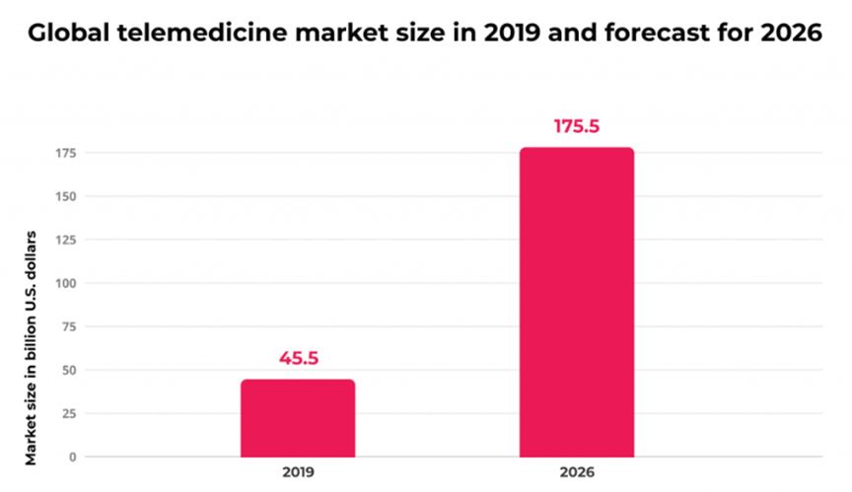
AI and Telehealth
AI emerging with telehealth in the future holds great potential with healthcare brought to a user’s doorstep. In 2026 it is predicted that the global telemedicine market size will increase greatly compared to the previous years. AI emerging with telehealth brings people more accessibility with their health care needs and more options regarding their health.
AI emerging with Telehealth brings:
Quicker diagnosis
More accessibility
Faster general health information
More efficiency
Note:Image from SPsoft. (2023, January 24). The key issues and challenges for AI-based telehealth. LinkedIn. https://www.linkedin.com/pulse/key-issues-challenges-ai-based-telehealth-spsoft-com
Notes:
AI and telehealth brings quicker diagnosis and help from virtual services which gives more accessibility to patients. AI with telehealth can give patients faster results and diagnosis or even helpful advice if they are stuck on a urgent question and need general health information. Since the phone lines with registered nurses can be filled with patients needing live help, AI can help with efficiency by handling the smaller and simpler cases so that there is a less workload for the nurses while also helping patients at the same time.

Slide 28
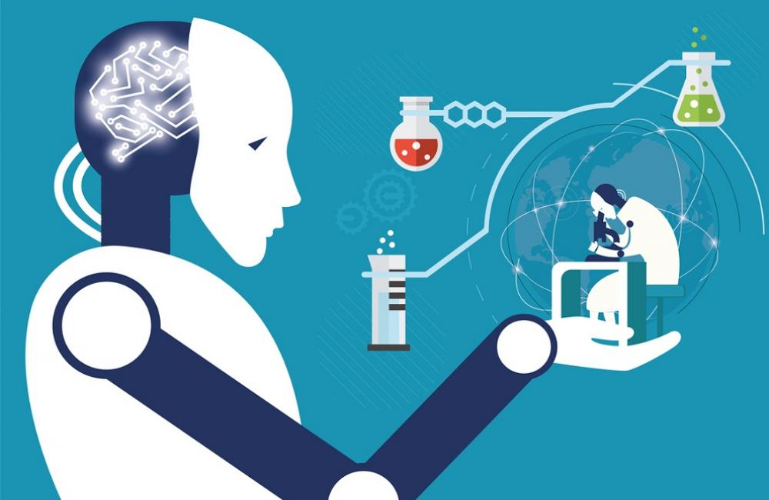
Uses of AI in Medicine Beyond Diagnosis
We expect AI will be able to help find new drugs for treatments, plan treatments, and monitor patients.
AI will aid through combining medical information such as RNA and DNA data.
AI would be able to help in treatment for rare diseases as well, however this would be rather difficult, as there is not a great variety of data sets available for these rare diseases (Luchini et al., 2021).

Slide 29
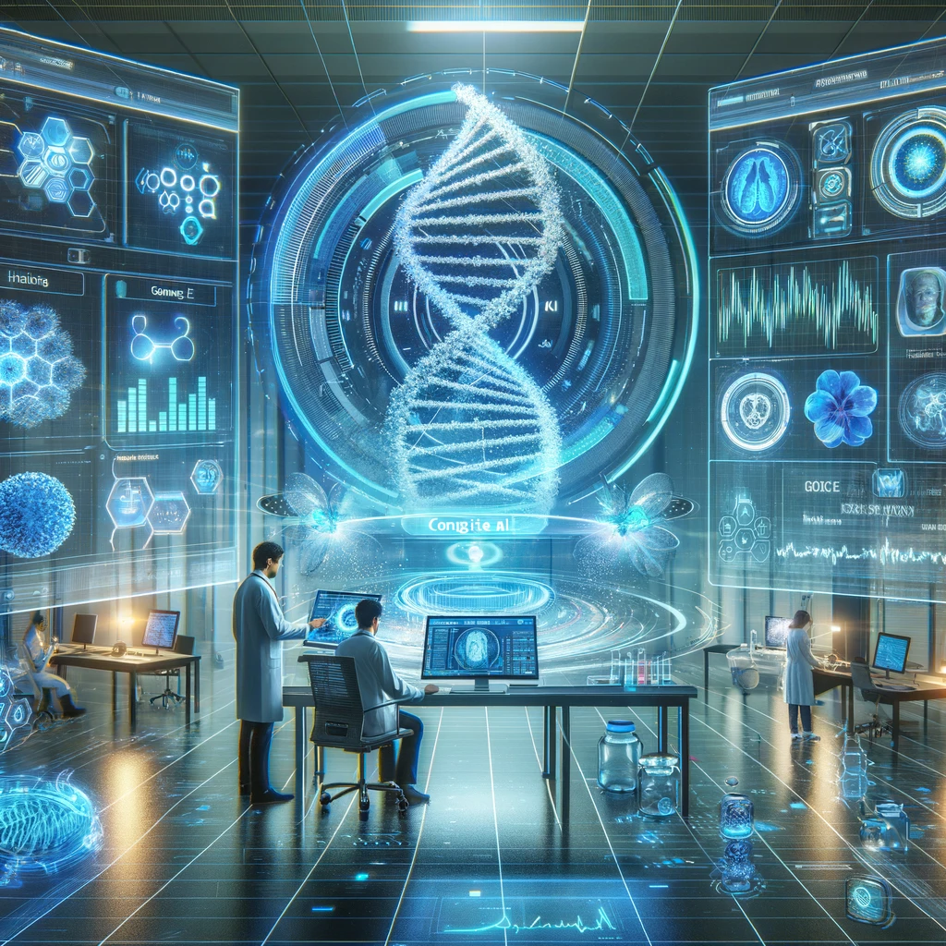
How will AI be applied to medicine in the future?
AI will help find new drugs by analyzing datasets of existing drugs and their properties, to find its applications for new diseases or infections.
AI could use generative models to design molecular structures which could be used to create drugs, treat and cure diseases, optimizing the formulation of the compounds to enhance efficiency.
In addition, through its access to the updated data, it would be able to flag any concerns, which it might pull from a combination of recent and past medical information (Romm & Tsigelny, 2020).
Through AI’s continuous help in various aspects of medicine, the treatment of patients will improve significantly, which would mean that the survival rates of diseases would increase as well, mirroring a healthier and happier population in the future.

Slide 30
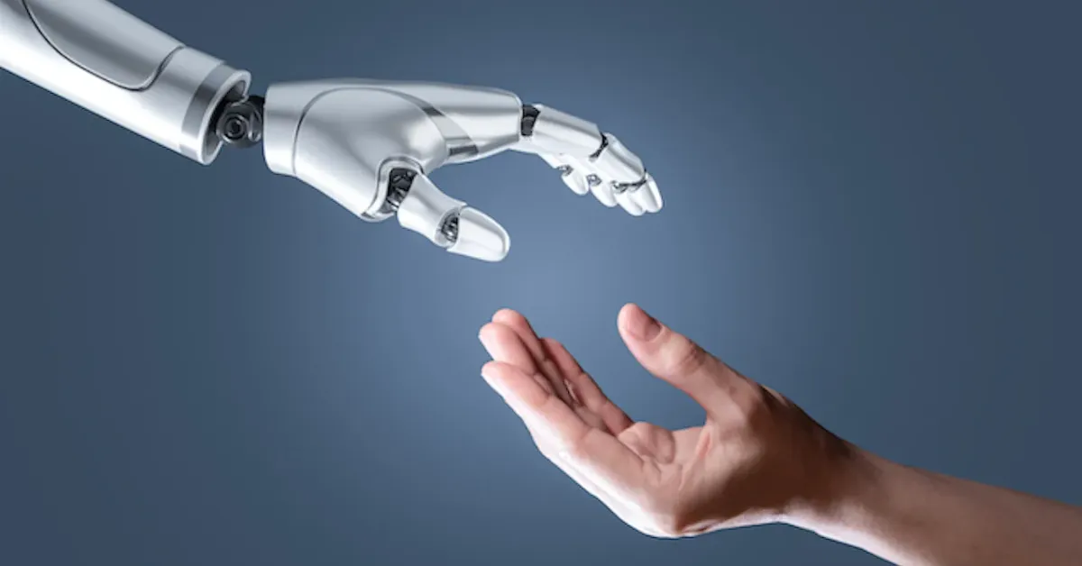
AI is Less Effective for Minorities Today in Medicine
A current concern for AI in public services and public health, is the lack of data it has for minority groups.
This translates to it not being able to help minorities and underrepresented groups to its full potential, as it would have less data to pull from, making its solutions and plans less efficient.
This could lead to grave and serious concerns, and in the field of healthcare, even death, as a solution that may work for someone who is Caucasian may not work for someone who is a minority.

Slide 31

AI Will Become More Effective for Minorities in the Medical Field
We expect that there will be more emphasis in seeking and acquiring more data to better serve all people from different backgrounds.
This may raise ethical concerns as there would be a more targeted pressure in acquiring more data from a certain group of people, which may not be used for its intended purpose.
There should be strict rules and regulations in place to protect the privacy of all people during this process, and to ensure the data had been acquired through proper consent (Andreotta et al., 2021).
The future outlook of this ensures that AI benefits people from underrepresented communities as much as people from privileged communities.

Slide 32
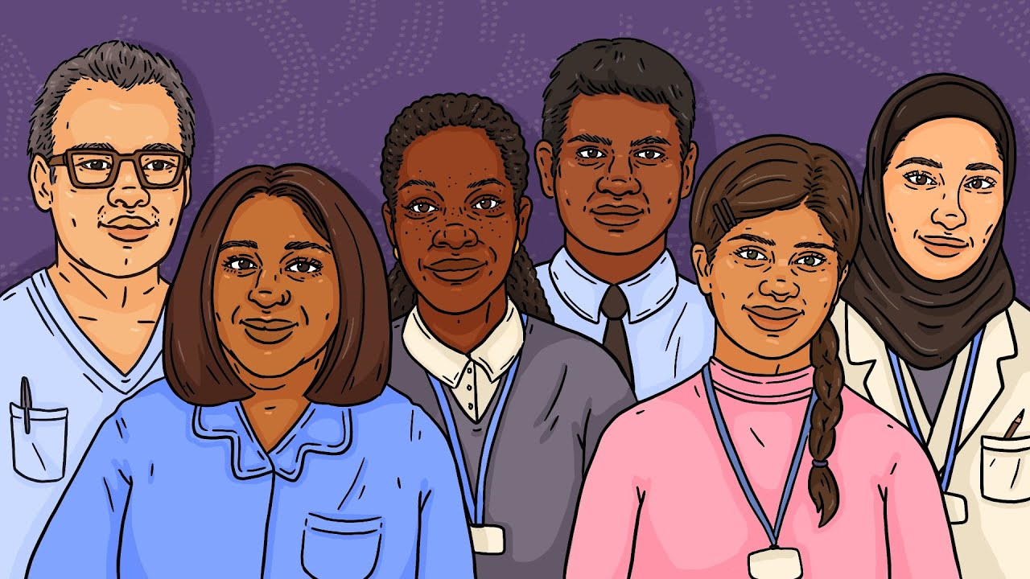
Its Positive Effect on Society
This is crucial for the inclusivity and well-being of a society, in healthcare, education, employment, entertainment, etc.
These different aspects of life are related to healthcare, for example education is required for professionals who contribute to the health industry, there are professionals who are employed in the health industry, there are certain types of entertainment and leisure which have a higher risk of injury.
As AI improves efficacy in all these aspects through its commitment for equality and equity, it would influence the equivalent for the medical field directly and indirectly.

Slide 33
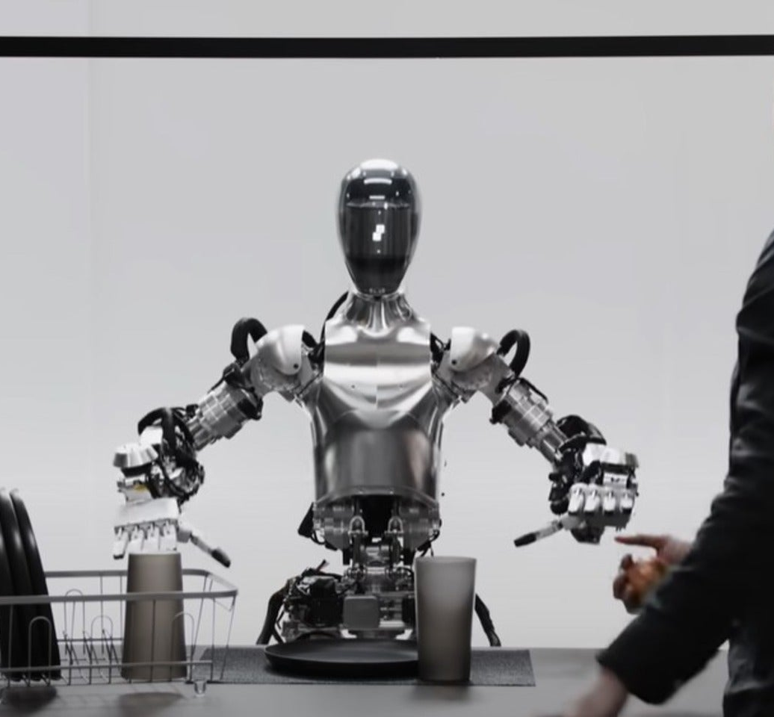

Navigating Five Years of AI Development
Future Outlook
What is covered::
Exploring AI’s promising yet uncertain future in healthcare
Highlighting the rapid pace of recent AI Advancements
Envisioning a balanced integration of AI into healthcare
Embracing optimism and realism about AI’s potential impact
Reminder: Context is key for projecting AI’s Future Development.

Slide 34

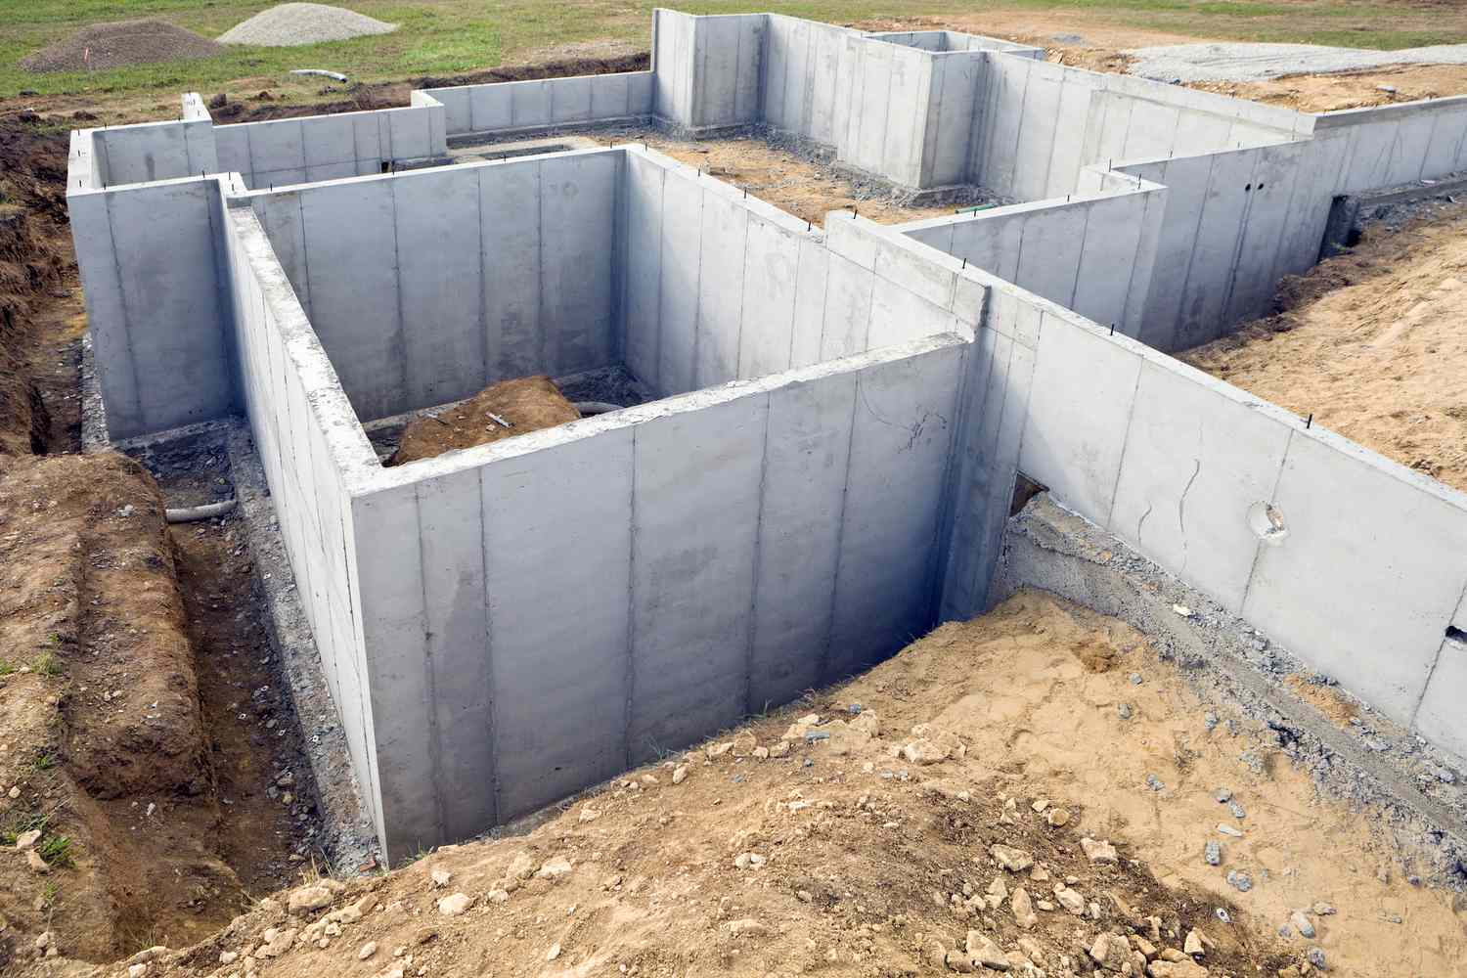
2023 & 2024
Future Outlook
Launch initiatives to create diverse AI training datasets.
Form global partnerships for data and research exchange.
Establish ethical guidelines for AI use in healthcare.
Foundation

Slide 35
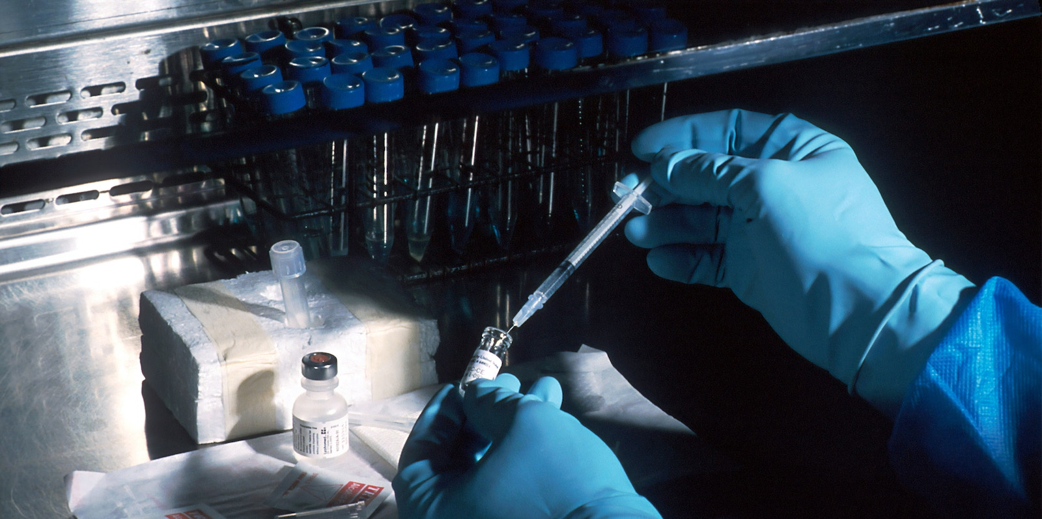
2025
Future Outlook
Enhance personalized medicine through AI and genomics integration.
Develop AI tools for early disease detection.
Innovate advanced AI algorithms for disease prediction and treatment planning.
Research and Development

Slide 36
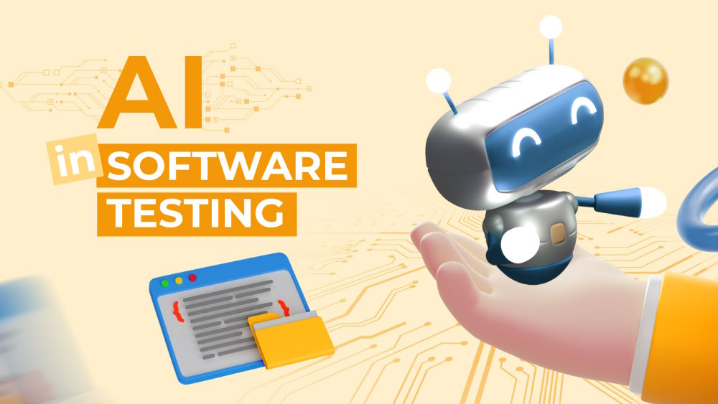
2026
Future Outlook
Conduct clinical trials to assess AI systems’ effectiveness in healthcare.
Integrate AI with telehealth services to improve healthcare accessibility.
Use AI for operational efficiencies in healthcare facilities.
Implementing & Testing

Slide 37

2027 & 2028
Future Outlook
Apply AI in drug discovery, advancing clinical trials for new treatments.
Initiate AI projects targeting global health challenges.
Explore AI applications in emerging healthcare fields like mental health and regenerative medicine.
Optimizing & Expansion

Slide 38
In Closing…

Slide 39
Overall Benefits
Optimize healthcare systems
Improve patient care
Improve global health
Combat stressors imposed by growing population
of AI in Healthcare:
Notes:
Oriana
Global cancer burden growing, amidst mounting need for services. (2024, February 1). Www.who.int. https://www.who.int/news/item/01-02-2024-global-cancer-burden-growing--amidst-mounting-need-for-services#:~:text=In%202022%2C%20there%20were%20an

Slide 40
References
Ahmad, Z., Rahim, S., Zubair, M., & Abdul-Ghafar, J. (2021, March 17). Artificial Intelligence (AI) in medicine, current applications and future role with special emphasis on its potential and promise in pathology: Present and future impact, obstacles including costs and acceptance among pathologists, practical and philosophical considerations. A Comprehensive Review - Diagnostic Pathology. SpringerLink. https://link.springer.com/article/10.1186/s13000-021-01085-4
Andreotta, A. J., Kirkham, N., & Rizzi, M. (2021, August 30). Ai, Big Data, and the future of consent - AI & Society. SpringerLink. https://link.springer.com/article/10.1007/s00146-021-01262-5
Arora, N., Banerjee, A. K., & Narasu, M. L. (2020). The role of artificial intelligence in tackling COVID-19. Future Virology, 15(11). https://doi.org/10.2217/fvl-2020-0130
Beede, E., Baylor, E., Hersch, F., Iurchenko, A., Wilcox, L., Ruamviboonsuk P., Vardoulakis, L. M. (2020). A human-centered evaluation of a deep learning system deployed in clinics for the detection of diabetic retinopathy. Proceedings of the 2020 CHI Conference on Human Factors in Computing Systems, 1-12. https://doi.org/10.1145/3313831.3376718
Callaway, E. (2022). Scientists are using AI to dream up revolutionary new proteins. Nature, 609, 661-662. https://doi.org/10.1038/d41586-022-02947-7
Callaway, E. (2022). What’s next for AlphaFold and the AI protein-folding revolution. Nature, 604, 234-238. https://doi.org/10.1038/d41586-022-00997-5
Chun, M. (2023, March 20). How artificial intelligence is revolutionizing drug discovery. Harvard Law Bill of Health. https://blog.petrieflom.law.harvard.edu/2023/03/20/how-artificial-intelligence-is-revolutionizing-drug-discovery/
Dilmegani, C. (2023, September 11). Bias in AI: What it is, Types & Examples, How & Tools to fix it. AppliedAI. https://research.aimultiple.com/ai-bias/
Eskreis‐Winkler, S., Onishi, N., Pinker, K., Reiner, J. S., Kaplan, J. B., Morris, E. A., & Sutton, E. (2021). Using Deep Learning to Improve Nonsystematic Viewing of Breast Cancer on MRI. Journal of Breast Imaging, 3(2), 201–207. https://doi.org/10.1093/jbi/wbaa102
Fong, S. J., Dey, N., & Chaki, J. (2021). Artificial Intelligence for Coronavirus Outbreak. In SpringerBriefs in Applied Sciences and Technology. Springer Singapore. https://doi.org/10.1007/978-981-15-5936-5
Glazier R. H. (2023). Our role in making the Canadian health care system one of the world's best: How family medicine and primary care can transform-and bring the rest of the system with us. Canadian family physician Medecin de famille canadien, 69(1), 11–16. https://doi.org/10.46747/cfp.690111
Global cancer burden growing, amidst mounting need for services. (2024, February 1). Www.who.int. https://www.who.int/news/item/01-02-2024-global-cancer-burden-growing--amidst-mounting-need-for-services#:~:text=In%202022%2C%20there%20were%20an
Gold, M., Amatniek, J., Carrillo, M. C., Cedarbaum, J. M., Hendrix, J. A., Miller, B. B., Robillard, J. M., Rice, J. J., Soares, H., Tome, M. B., Tarnanas, I., Vargas, G., Bain, L. J., & Czaja, S. J. (2018). Digital technologies as biomarkers, clinical outcomes assessment, and recruitment tools in Alzheimer's disease clinical trials. Alzheimer’s & Dementia: Translational Research & Clinical Interventions, 4, 234-242. https://doi.org/10.1016/j.trci.2018.04.003

Slide 41
References
Huang, L., Shi, P., Zhu, H., & Chen, T. (2022). Early detection of emergency events from social media: a new text clustering approach. Natural Hazards, 111(1), 851–875. https://doi.org/10.1007/s11069-021-05081-1
Johnson, K. B., Wei, W. Q., Weeraratne, D., Frisse, M. E., Misulis, K., Rhee, K., Zhao, J., & Snowdon, J. L. (2021). Precision Medicine, AI, and the Future of Personalized Health Care. Clinical and translational science, 14(1), 86–93. https://doi.org/10.1111/cts.12884
Luchini, C., Pea, A., & Scarpa, A. (2021, November 26). Artificial Intelligence in oncology: Current applications and future perspectives. Nature News. https://www.nature.com/articles/s41416-021-01633-1
Mock, M., Edavettal, S., Langmead, C., & Russel, A. (2023). AI can help to speed up drug discovery – but only if we give it the right data. Nature, 621, 467-470. https://doi.org/10.1038/d41586-023-02896-9
Najjar, R. (2023, August 25). Redefining radiology: A Review of Artificial Intelligence Integration in medical imaging. Diagnostics (Basel, Switzerland). https://www.ncbi.nlm.nih.gov/pmc/articles/PMC10487271/
Paul, D., Sanap, G., Shenoy, S., Kalyane, D., Kalia, K., & Tekade, R. K. (2021). Artificial intelligence in drug discovery and development. Drug discovery today, 26(1), 80–93. https://doi.org/10.1016/j.drudis.2020.10.010
Romm, E. L., & Tsigelny, I. F. (2020, January 6). Artificial Intelligence in drug treatment. Annual Review of Pharmacology and Toxicology. https://www.annualreviews.org/content/journals/10.1146/annurev-pharmtox-010919-023746
Samson, J. (2023, September 25). AI-powered precision: Advancing Diagnostics with Medical Imaging Technology. LinkedIn. https://www.linkedin.com/pulse/ai-powered-precision-advancing-diagnostics-medical-imaging-samson
SPsoft. (2023, January 24). The key issues and challenges for AI-based telehealth. LinkedIn. https://www.linkedin.com/pulse/key-issues-challenges-ai-based-telehealth-spsoft-com
United Nations. (n.d.). Global issues: Population. https://www.un.org/en/global-issues/population.
Vaishya, R., Javaid, M., Khan, I. H., & Haleem, A. (2020). Artificial Intelligence (AI) applications for COVID-19 pandemic. Diabetes & Metabolic Syndrome: Clinical Research & Reviews, 14(4), 337–339. https://www.sciencedirect.com/science/article/pii/S1871402120300771
Zhang, Z., Lu, Y., Soroush Vosoughi, Levy, J., Christensen, B., & Salas, L. (2023). HiTAIC: hierarchical tumor artificial intelligence classifier traces tissue of origin and tumor type in primary and metastasized tumors using DNA methylation. NAR Cancer, 5(2). https://doi.org/10.1093/narcan/zcad017

